Slide 1
Introduction to Gradle
Koby aharon
April 2015

Slide 2
A little about me
Developer in the DI lab (iSpreads team)
Joined Citi about 5 months ago
Worked as a build manager in previous job
5+ years of experience with java build tools

Slide 3
Agenda
Build tools overview
Ant
Maven
Why do we need another build tool?
Gradle overview
Demo
Summary

Slide 4
Build Tools Overview

Slide 5

Ant
Java based build tool from Apache
Started as part of Tomcat
Moved to a separate project in early 2000
Files are written in XML

Slide 6
Ant - Build file example
<project name="MyProject" default="dist" basedir=".">
<property name="src" location="src"/>
<property name="build" location="build"/>
<property name="dist" location="dist"/>
<target name="init">
<tstamp/>
<mkdir dir="${build}"/>
</target>
<target name="compile" depends="init" >
<javac srcdir="${src}" destdir="${build}"/>
</target>
<target name="dist" depends="compile" >
<mkdir dir="${dist}/lib"/>
<jar jarfile="${dist}/lib/MyProject-${DSTAMP}.jar" basedir="${build}"/>
</target>
</project>

Slide 7
Ant – Pros/Cons
Pros
Very easy to learn.
Full control over the build process.
No “magic”
Cons
Most builds contain huge XML files
Hard to maintain
XML format to write “code”
No convention

Slide 8

Maven
Released in 2004
Most popular java build tool
Introduced dependency management
Introduced multi module concept
Relies on convention over configuration
Uses plugin architecture
Files are written in XML

Slide 9
Maven – key features
Simple project setup that follows best practices
Extensible via plugins
Defines build lifecycles and phases. Plugin goals are attached to defined phases.
Declarative over imperative
Consist usage across all projects
Dependency management (no need to commit jars to SCM)
Multi module support

Slide 10
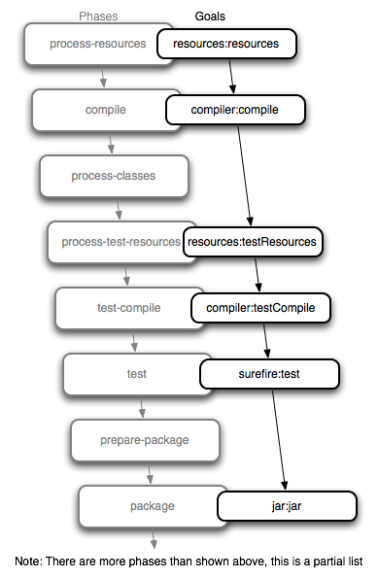
Maven – default (build) lifecycle
Notes:
Maven build life cycles:
1. clean → pre-clean,clean,post-clean
2. default (build)
3. site → pre-site, site, post-site, site-deploy

Slide 11
Maven – POM example
<project>
<modelVersion>4.0.0</modelVersion>
<groupId>org.gradleintro.example</groupId>
<artifactId>example</artifactId>
<version>1.0-SNAPSHOT</version>
<packaging>jar</packaging>
<name>Maven Example POM file</name>
<dependencies>
<dependency>
<groupId>junit</groupId>
<artifactId>junit</artifactId>
<version>4.8.2</version>
<scope>test</scope>
</dependency>
</dependencies>
</project>
Every build module is enclosed within a “project” tag
Module’s coordinates
Module’s dependency list

Slide 12



why
another
Build
Tool?
Notes:
* Projects today contain a lot of different modules from different languages (polyglot build)
* Both Maven and ant presented key innovations, however today there are more demands from a build tool. (polyglot build, deployment pipelines, etc.)
* Most projects are very different than one another including their build requirements.

Slide 13

Gradle
First released in 2009
Project automation tool
Build upon the concepts of Maven and Ant
Files are written in Groovy using a dedicated DSL

Slide 14
Gradle – key features
Very flexible
Ease of migration
Declarative builds and build-by-convention
Multi module support
Dependency management support (richer than Maven)
Gradle wrapper (simple installation)
Build files are written in Groovy
No build lifecycle. You define the task graph.

Slide 15
Gradle - build tools position
Ant
Maven
Gradle

Slide 16
Gradle – main entities
Project – Every build file in made up of one or more projects (can represent a jar file, war file, etc.)
Task – Represent atomic piece of work. Project contains multiple tasks while every task can have several actions.

Slide 17
Gradle – hello world example
build.gradle
task helloWorld {
doLast {
println “hello, world"
}
}
Define a new task called “helloWorld” with an action that
output “hello, world” to the console

Slide 18
Gradle – hello world example
task hello
task world
task helloWorld {
dependsOn = [ world, hello ]
}
world {
dependsOn << hello
doLast {
println "world"
}
}
hello {
doLast {
print "hello, "
}
}
Defines 2 tasks “hello” and “world”
Define another task “helloWorld” and
configures it’s task dependencies
Configure the previously defined “world” task
Add task “hello” to task “world” dependency list
(using Groovy’s “<<“ operator)
Add an activity to task “world” activity list. Task can contain
Multiple activities.
Configure the previously defined “hello” task
Add an activity to task “hello” activity list.

Slide 19
Gradle – build.gradle java module
apply plugin: 'java'
group = 'org.gradleintro.example'
version = '1.0-SNAPSHOT'
dependencies {
testCompile 'junit:junit:4.11'
}
Activates java plugin
Defines module coordinates
List of module’s dependencies

Slide 20
DEMO

Slide 21
Personal story
Worked on a multi-module Maven project containing more than 200 modules
Maven build times:
Full build without tests – 40 minutes
Full build with unit tests – 50 minutes
Full build with full tests suite (unit + integration + async) – 1 hr 30 min
Created an Hybrid Gradle + Maven build and decreased build time to 12 minutes on average using Gradle’s incremental build
Example code is hosted on Github.

Slide 22
Summary

Slide 23
Build Tools – Pros/Cons
 | Ant | Maven | Gradle
Pros | Easy to learn and use Full control over the build process. No “magic” | Very good IDE support Standard build process Easy to move between projects Lot of plugins | Very flexible Incremental build Large community Great documentation Groovy code Both Declarative as well as imperative
Cons | Large XML files Hard to maintain XML format to write “code” Very imperative | Learning curve Not flexible Partial multi-module support Not suitable for large projects | Fragile IDE support Learning curve Groovy code
Notes:
Maven:
Partial multi module support -> modules are dependent as artifacts so for example if A depends on B, and you want to build only A, B will be searches for in the repository and won’t be build automatically (supported in Maven 3 using “–pl” and “–am”, however you need to explicitly list the module and can be executed only from the
root).

